Slide 1

The probability scale
Task A: Expressing probabilities: percentages and decimals
1) Write the probabilities below in the correct order on the probability scale.
0%, 100%, 20%, 75%, 50%, 45%, 55%
0%
20%
45%
50%
55%
75%
100%
impossible
unlikely
even chance
likely
certain
2) Write the probabilities below in the correct order on the probability scale.
1, 0, 0.5, 0.1, 0.35, 0.95, 0.6
0
0.1
0.35
0.5
0.6
0.95
1
impossible
unlikely
even chance
likely
certain
3) In each question you are given a spinner and a choice of four probabilities. In each question, tick the probability that the spinner would land on ‘win’.
a)
0.5%
b)
0
c)
0.1
win
lose
1%
0.5
lose
0.45
2%
win
1
win
0.5
50%
100
0.9
d)
40%
e)
50%
f)
0.1
win
lose
50%
win
52%
win
lose
0.45
52%
lose
75%
0.5
95%
98%
0.6

Slide 2
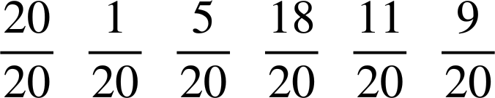
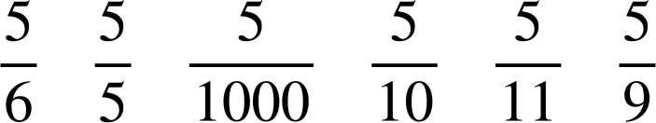
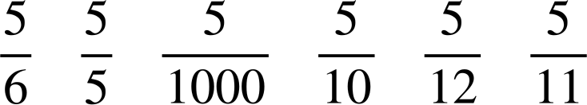

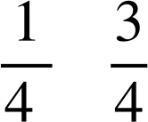

The probability scale
Task B: Expressing probabilities as fractions
1) Write the probabilities below in the correct order on the probability scale.
impossible
unlikely
even chance
likely
certain
2) Write the probabilities below in the correct order on the probability scale.
impossible
unlikely
even chance
likely
certain
3) Fill in the blanks in the table.
event | probability as a fraction | probability as a decimal | probability as a percentage | description of likelihood | expected frequency in 600 trials
example |  | 0.5 | 50% | even chance | 300
A |  | 0.25 |  | unlikely
B |  |  | 75%
C
D |  |  |  |  | 0
25%
150
0.75
likely
450
0.4
40%
unlikely
240
0
0
0%
impossible

Slide 3

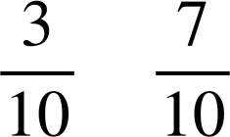
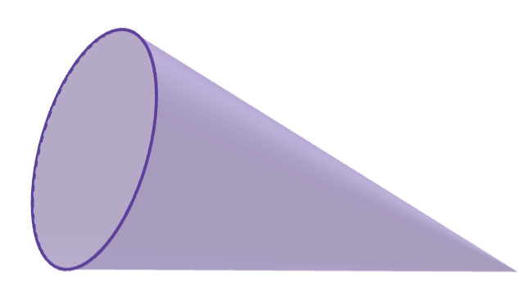
The probability scale
4) A dropped cone could land in one of two ways: ‘base down’ or ‘curve down’.
A large experiment concluded the following probabilities:
P(base down) = P(curve down) =
a) The cone is about to be dropped again. Which outcome is most likely to happen?
curve down
b) In an experiment with 100 trials, approximately how many times could you expect the cone to land curve down?
of 100 = 70
c) Use the link to access a simulation of this experiment: Cone simulation🖇 The box that says ‘count’ shows the number of trials completed. Press the ‘run’ button to begin the simulation and let it run for 100 trials.
Are the results the same as what you predicted in part (b)?
Example answers:
‘The results were similar to my prediction but not the same.’
‘There were 89 results for curve down, which is more than what I expected.’
‘The number of times it landed curve down was much more than the number of times it landed base down, which was what I expected. But the exact number of times it landed on each side differed to what I expected.’
Answers may vary depending on results from the simulation.
Mathematics in Education and Industry
v2.3

